Slide 1

46-888 Optimization for Prescriptive Analytics
Module 5: Live Session

Slide 2
Topics
Integer Programming Applications
Minimum order/discounts
Facility location
Location/distribution
Questions?

Slide 3
Common Theme
All these applications used binary variables
can be used to turn constraints ‘on’ or ‘off’
can be used to turn variables ‘on’ or ‘off’
In all cases, the trick is to use linkage constraints to connect the binary variables to the other variables
e.g., y₁+y₂+y₃+y₄ ≤ 3x where x is a binary variable

Slide 4
Today’s agenda
Case: Transportation Contracting
Example of ‘fixed cost’ and ‘location/distribution’
Develop integer programming model
Implementation in Python
Pajunas, Matto, Trick, and Zuluaga. Optimizing Highway Transportation at the United States Postal Services. Interfaces, 2007. (Posted on Canvas)

Slide 5

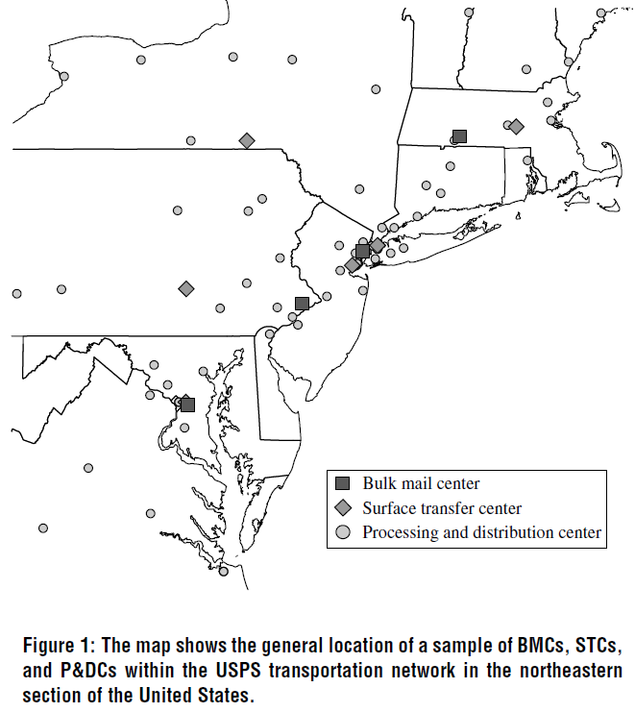
USPS Transportation Network
USPS delivers more than 2 billion pieces of mail each year
different mail types (letters, parcels,…)
different mail classes (priority, first, …)
Each piece is routed through the transportation network
separate networks per mail type and mail class, but interconnected
Main issue: how to route shipments between locations in network?

Slide 6
Capacity Planning and Route Allocation
We need to perform a set of deliveries
Allocate deliveries to trucks that follow pre-specified trips
A trip consists of several legs and has a fixed cost (if used)
Goal: minimize total cost
Example:
blue trip: 2 – 3 – 4
red trip: 1 – 2 – 4
Delivery from 2 to 4 can use either
trip (or split shipment along trips)
3
2
1
4

Slide 7
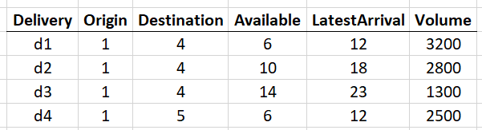
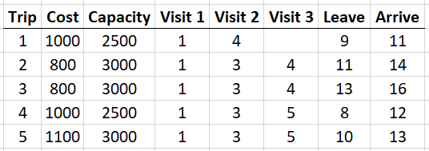
Example Case
origins
Snapshot of data:
destinations
1
4
hub
3
5
2
Deliveries: from origin locations to destination locations
Trips: either direct or via hub
See deliveries.csv and trips.csv

Slide 8
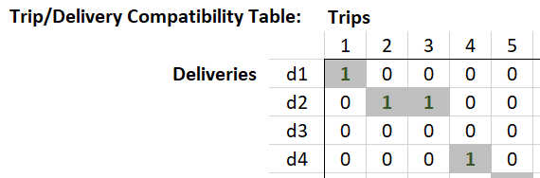
Data Analysis: Trip compatibility
Trip can perform delivery if:
trip route aligns with delivery origin and destination, and
trip leaves after delivery becomes available, and
trip arrives before delivery due date

Slide 9
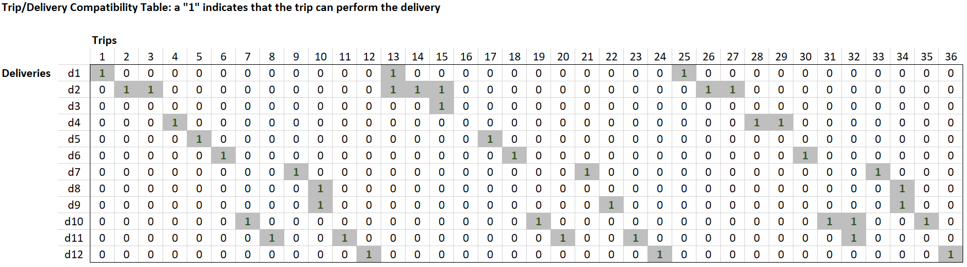
Data Analysis: Trip compatibility (full table)
Note: The data files do not contain this table. We need to define it in Python.

Slide 10
Input Data
Sets
D : set of deliveries
T : set of trips
Parameters
V_{i} : volume of delivery i in D
F_{r} : fixed cost of using trip r in T
K_{r} : capacity of trip r
A_{ir} : binary indicator representing whether delivery i can be routed on trip r
See data files: A_{ir} must be deduced from trip/delivery timing data

Slide 11
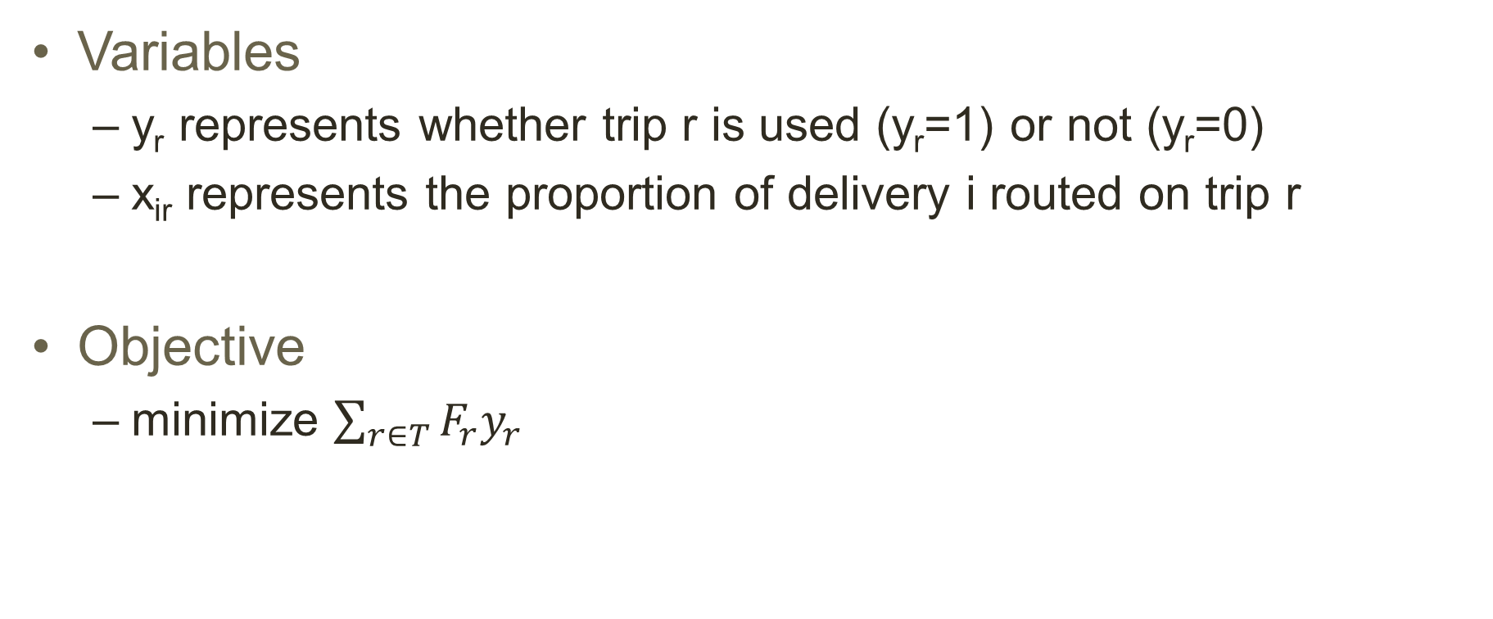
Integer Programming Model
Variables
y_{r} represents whether trip r is used (y_{r}=1) or not (y_{r}=0)
x_{ir} represents the proportion of delivery i routed on trip r
Objective
minimize $\sum_{r∈T}{F_{r}y_{r}}$

Slide 12
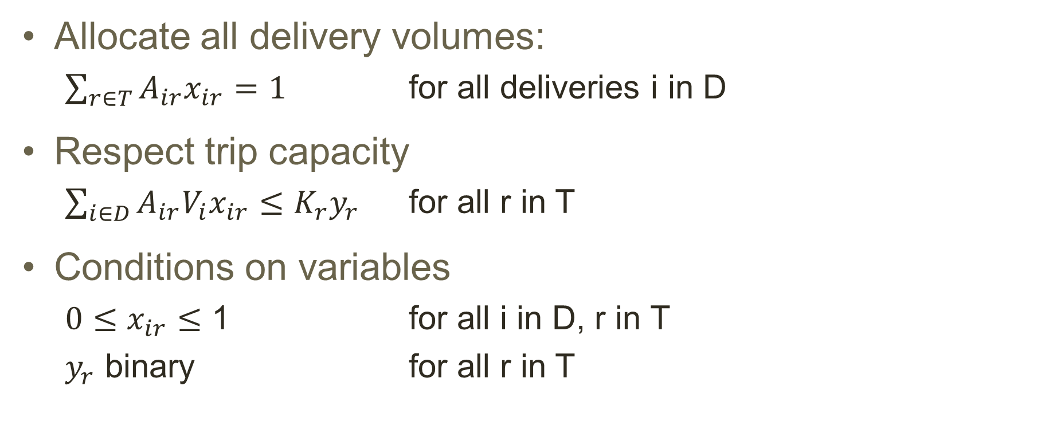
Constraints
Allocate all delivery volumes:
$\sum_{r∈T}{A_{ir}x_{ir}}=1$ for all deliveries i in D
Respect trip capacity
$\sum_{i∈D}{A_{ir}V_{i}x_{ir}}≤K_{r}y_{r}$ for all r in T
Conditions on variables
$0≤x_{ir}≤$ 1 for all i in D, r in T
$y_{r}$ binary for all r in T

Slide 13
Python Implementation
See usps pandas.ipynb

Slide 14
Model Extensions
Some shipments are not allowed to be split over multiple trips
for unsplittable shipments i: make x_{i} binary!
model does not need to be adapted in any other way
Each trip consists of several legs, and we have separate capacities per leg for each trip
introduce a new set of legs for each trip
binary indicator B_{irk} represents whether delivery i uses leg k on trip r
We also have variable costs based on volume shipped (per leg)
introduce a variable cost term in the objective based on V_{i}x_{ij}

Slide 15
Solving in practice
In 2007, this model would solve in reasonable time for about
200 shipments
50 trucks
Solving is difficult for more shipments and trucks
Model can be improved by adding ‘redundant’ constraints to help the solver (e.g., reason on volume shipped out before certain time)
In 2007: Added by model developers. Now: Automatic by CPLEX.
Scales up to about 5000 shipments and 500 trucks
Annual transportation savings of over $5M
Notes:
Example of redundant constraint:
Total shipment amount that must arrive before 12:00 is 9350. Based on the capacity of the trips (3000 maximum), we know that we need at least 4 trips.
Constraint: sum of the y-variables that arrive before 12:00 is at least 4.
(there are other, more involved, possible such constraints—see the paper)

